Slide 1
SCS User Guide
2024.07
Samsung Advanced Technology Academy

Slide 2
Contents
1
Overview
2
Download & Install the SW Certificate App
3
Run the SCS app
4
Login
5
Agreement to Privacy Policy & Info. Security Pledge
6
Select Problem
7
Solve Problem
8
End Test & Close SCS App
9
Detail feature

Slide 3
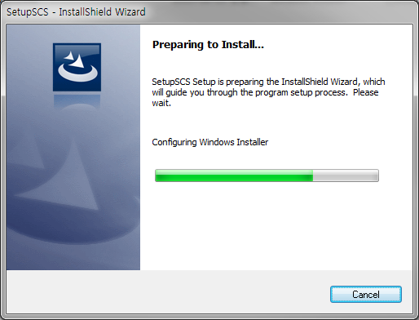
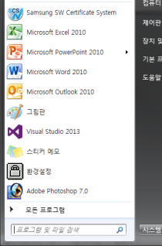
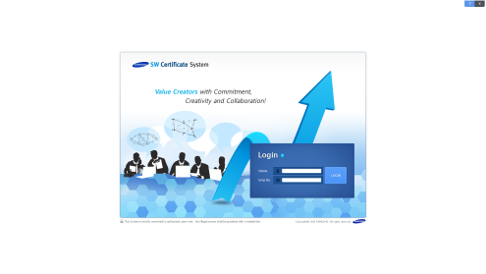
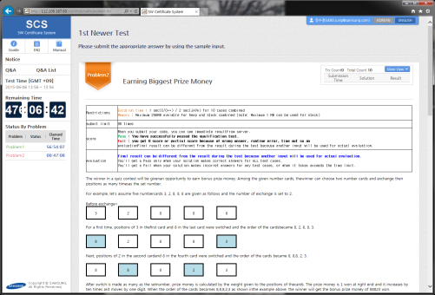
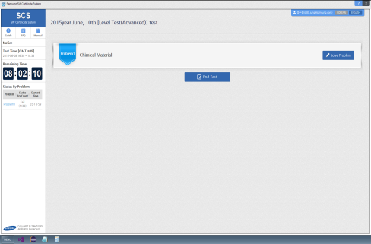
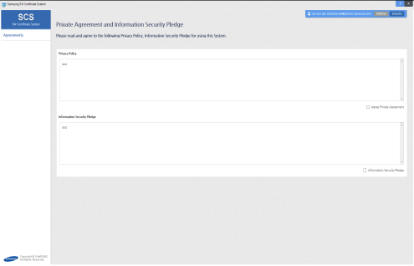
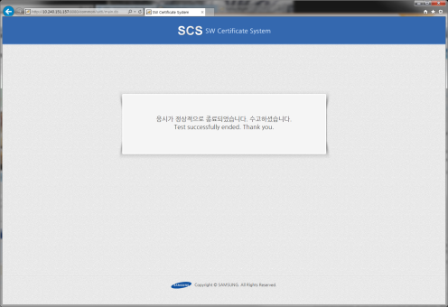
1. Overview
Download the SW Certificate program
(URL : http://scs.samsung.com/download/SCSSetup.zip)
Summary :
Install SCS App, run it, and perform SW test.
contents :
① SCS App Download & Install
② Run SCS App
③ Login
④ Agree to Samsung Privacy Policy.
⑤ Select a problem
⑥ Solve a problem
⑦ End Test & Close SCS App
1
2
3
6
5
4
7

Slide 4
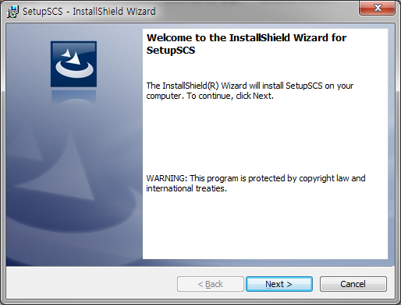
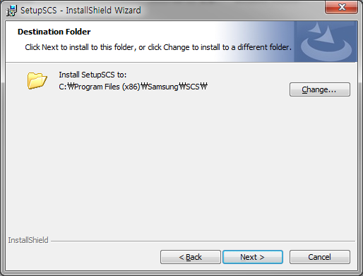
2. Download & Install the SW Certificate App – Install (1/2)
1. Download URL
http://scs.samsung.com/download/SCSSetup.zip
2. Unzip SCSSetup.zip
3. Run SCSSetup_1_0_21_SCS.exe
Summary :
Download & Install SCS App
Contents :
① Download → Unzip → Setup
② Default location:
C:\Program Files\Samsung\SCS\
or
C:\Program Files (x86)\Samsung\SCS\

Slide 5
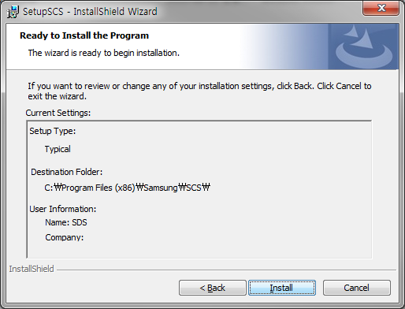
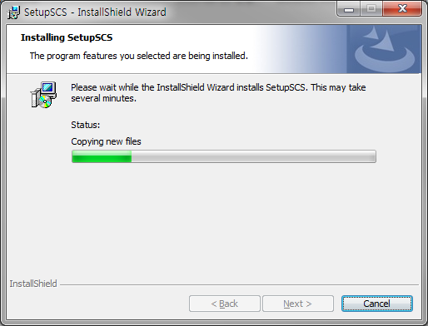
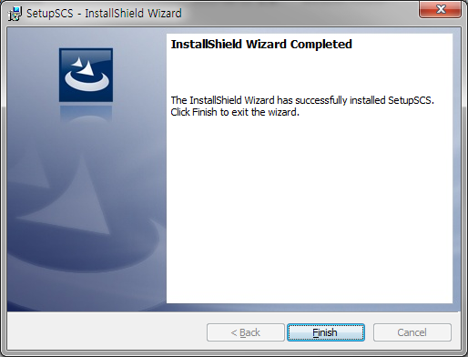

2. Download & Install the SW Certificate App – Install (2/2)
Summary :
Install SCS App
Contents :
① SCS will be added in the Window
program list & Short cut after
finishing install.

Slide 6

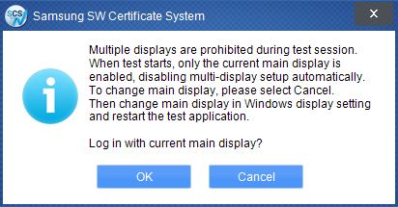
3. Run the SCS app
1
2
Summary :
SCS App Main screen
Contents :
① Run SCS App by start menu in the program list or Icon in the wallpaper.
② If Single Monitor, Log-in screen
would be displayed.
③ If multi monitor, Warning pop-up
would be displayed.
(Multi monitor should not be
allowed during the test by
company policy)
④ Sub Monitor will be off after
selecting OK button, and log-in
screen will be displayed.
⑤ If an user wants to change a main
monitor, he/she would close app
by selecting Cancel button, and
change monitor configuration in
the Windows setting.
Run App again.
If Single monitor ?
3
If Multi monitor ?
4
5

Slide 7

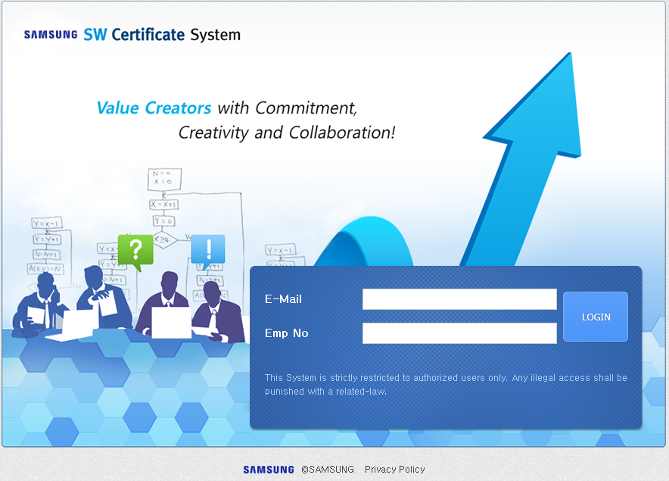
4. Login
4
5
Summary :
SCS App Login screen
Contents :
① Input E-mail address
- SEC employee :
ex) tom@samsung.com
- Candidate :
ex) tom@google.com
② Input Emp No
- SEC employee : Emp No.(GEN)
- Candidate :
Interviewer will give a ID
③ Login
④ Help about SCS App
⑤ Close App
1
3
2

Slide 8
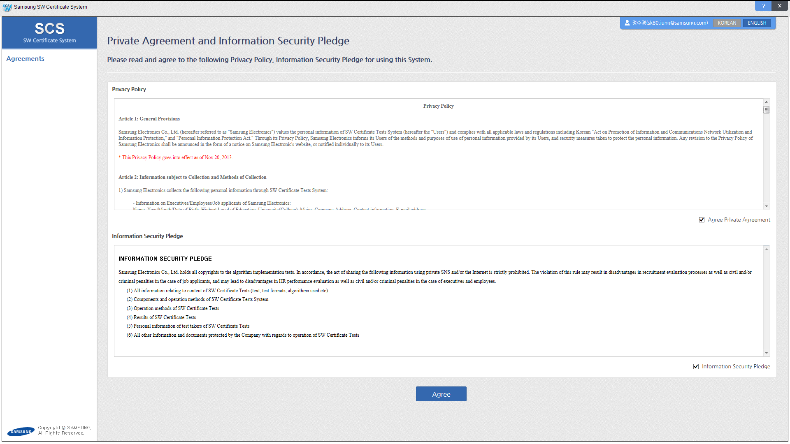
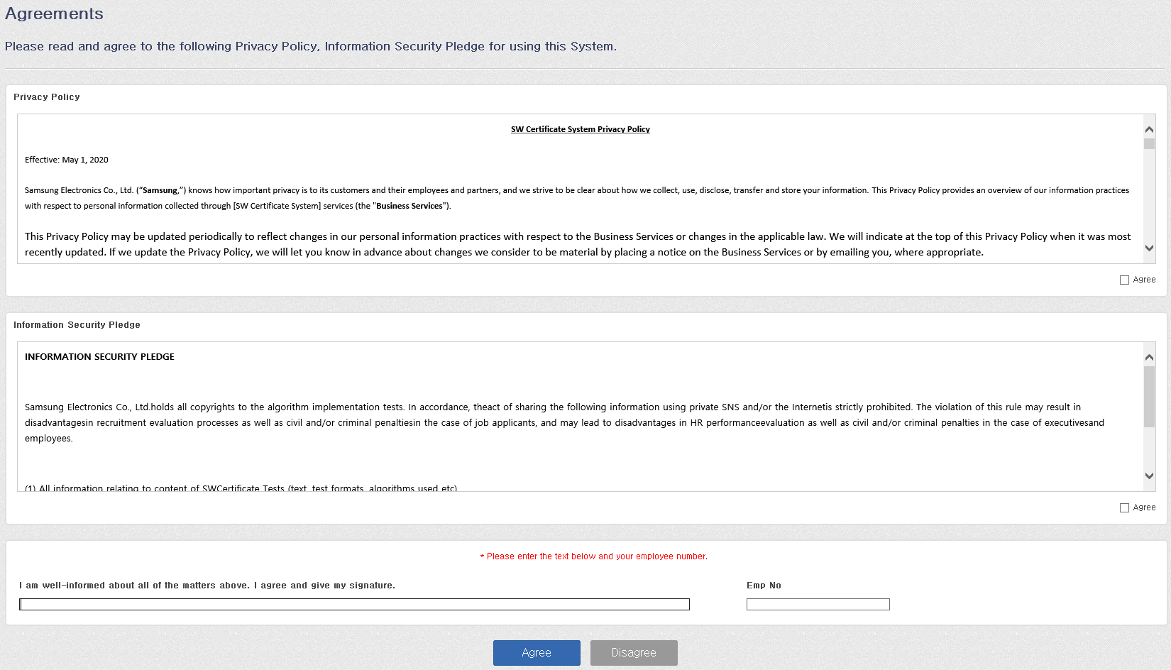
5. Agreement to Privacy Policy & Info. Security Pledge
5
Summary :
SCS App Agreements with using privacy information
Contents :
① Samsung Privacy Policy agreement
- Private agreement process
according to Privacy policy
② Information Security Pledge
agreement
- Non disclosure agreements about
all information about SCS
including questions.
③ Check if agree
④ Check if agree. Start test after
checking agreements.
⑤ If an user does not want to agree,
please close SCS app or clicking the Disagree button. In this case,
he/she cannot perform SCS.
1
3
2
3
3
3
4
5

Slide 9

6. Select Problem
Summary :
Problem Screen
Contents :
① Test Guide
② Test FAQ
③ System Manual
④ Notice
⑤ Test Time (From ~ To)
⑥ Test remaining Time
- Apply to all examinees equally
(Irrelevant to personal login time)
- Report answers before closing time
(Impossible to report answers after
closing time)
⑦ Status By Problem
Status by reporting answers,
Elapsed time
⑧ Select a problem & Start
If problems are more than 2, a user
should solve them in order.
⑨ End test and move to survey screen
⑩ Change a language
(Korean ↔ English)
1
2
3
10
4
5
8
6
9
7

Slide 10
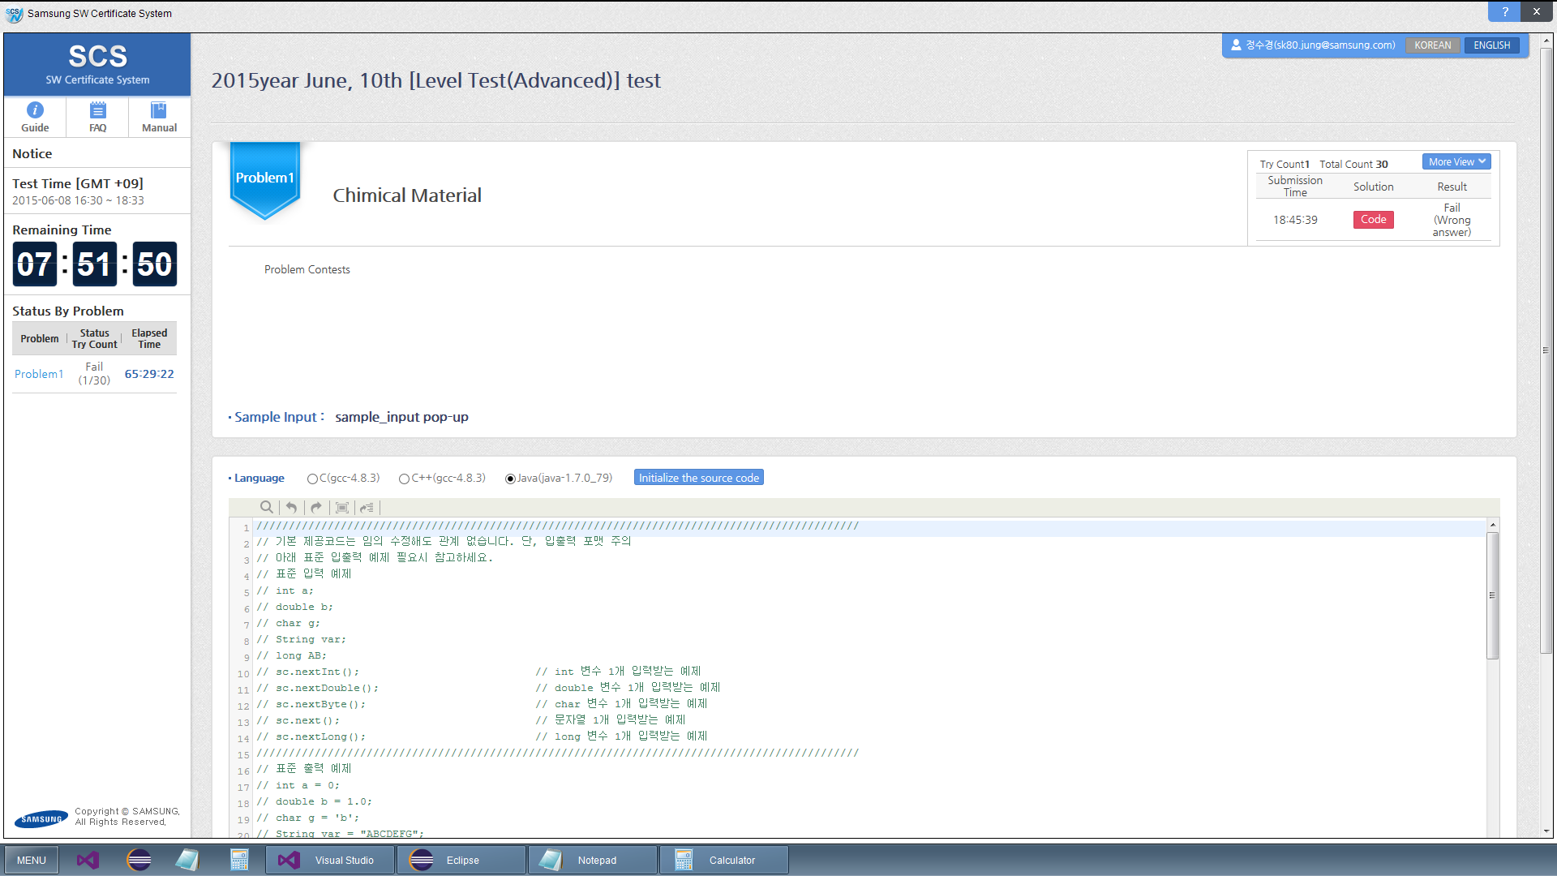
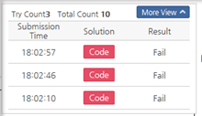

7. Solve Problem (1/6)
Problem Info.
Summary :
Problem Info.
Contents :
① Contents of the question displayed
② Status of report.
- Submission Time, Result
- Source code displayed by “Code”
button.
2
1

Slide 11
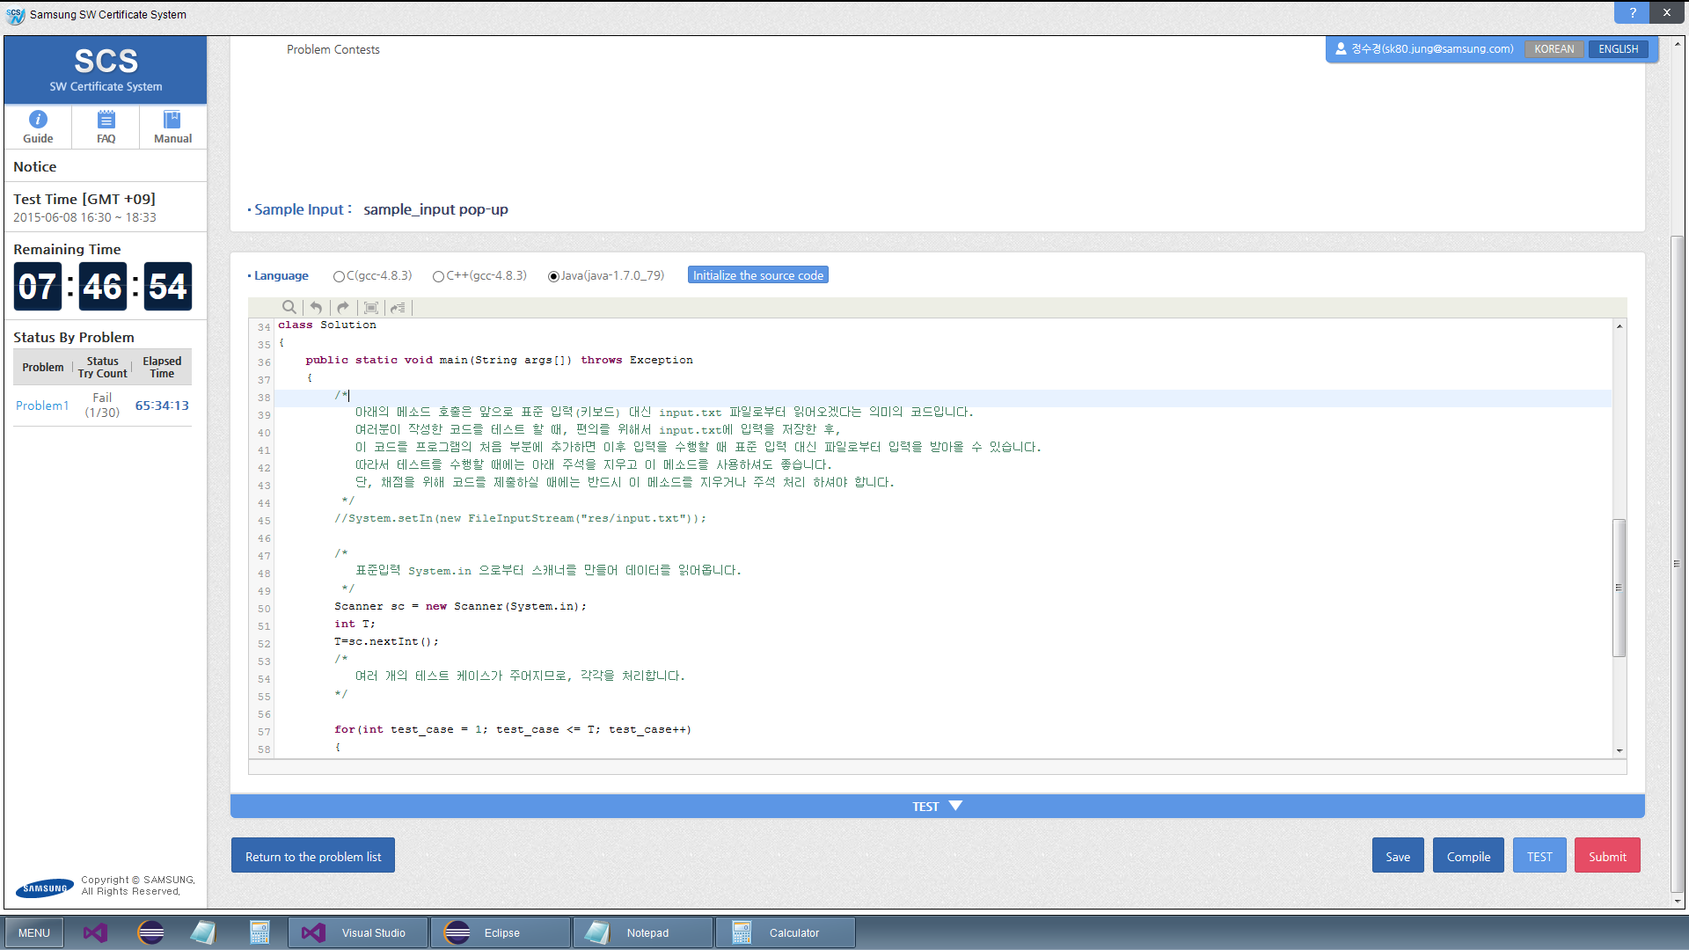
7. Solve Problem (2/6)
Sample_input & Default Code
Summary :
Contents of the problem screen
Contents :
Sample input data would be provided for testing an answer before reporting.
① Sample input pop-up displayed
Copy it from the pop-up screen
② Initialize a language or the source
code
③ Answer screen.
Default Code template provided.
If a user wants to design the
source code with other tools such
as Visual Studio, Eclipse or PyCharm
he/she should copy & paste it to
answer screen.
Save, compile, Submit, and Test
button
⑤ Return to the question list
1
2
3
5
4

Slide 12
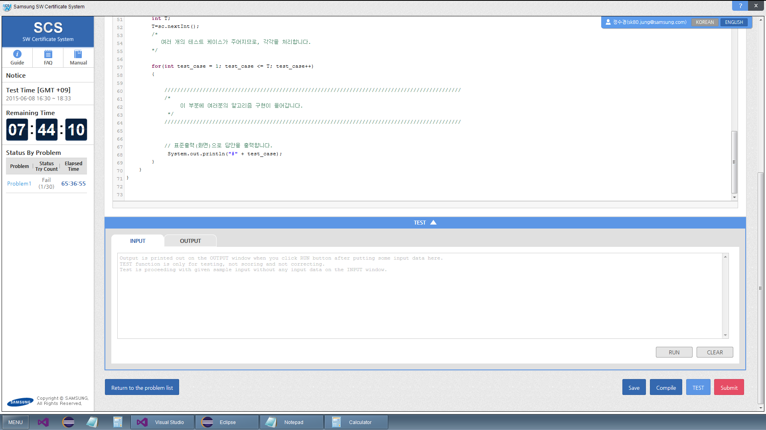
7. Solve Problem (3/6)
Input & Output Test
Summary :
Answer screen
Contents :
① Test screen with sample data would
be displayed or closed by “TEST” or
TEST▽ button.
② Input and output would be
displayed from SCS server.
- Input a sample data and select
“RUN” button on the “INPUT”
screen.
Compile, run the Source code
automatically, and display a result
on the “OUTPUT” screen.
- All data on the “INPUT” and
“OUTPUT” screen would be deleted
by “CLEAR” button.
1
2
1

Slide 13
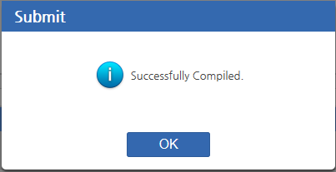
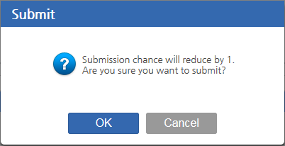
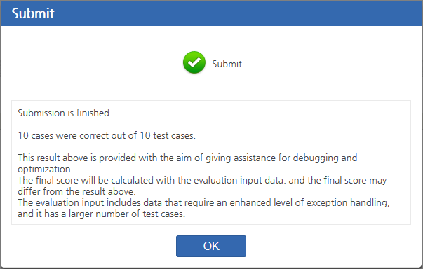
7. Solve Problem (4/6)
Submit & Sever task after submit
Summary :
Answer screen
Contents :
① If you click "Submit" button,
source submitted to the server.
The server task after submit.
② Compile source
- The error message displayed in
the program error
- The Success message displayed
in the normal compilation
③ Compile success
- confirm submit and submit count
reducing
④ Test case execution results are
displayed
- ex) 3 cases were correct out of 10
test cases.
1
2
3
4

Slide 14
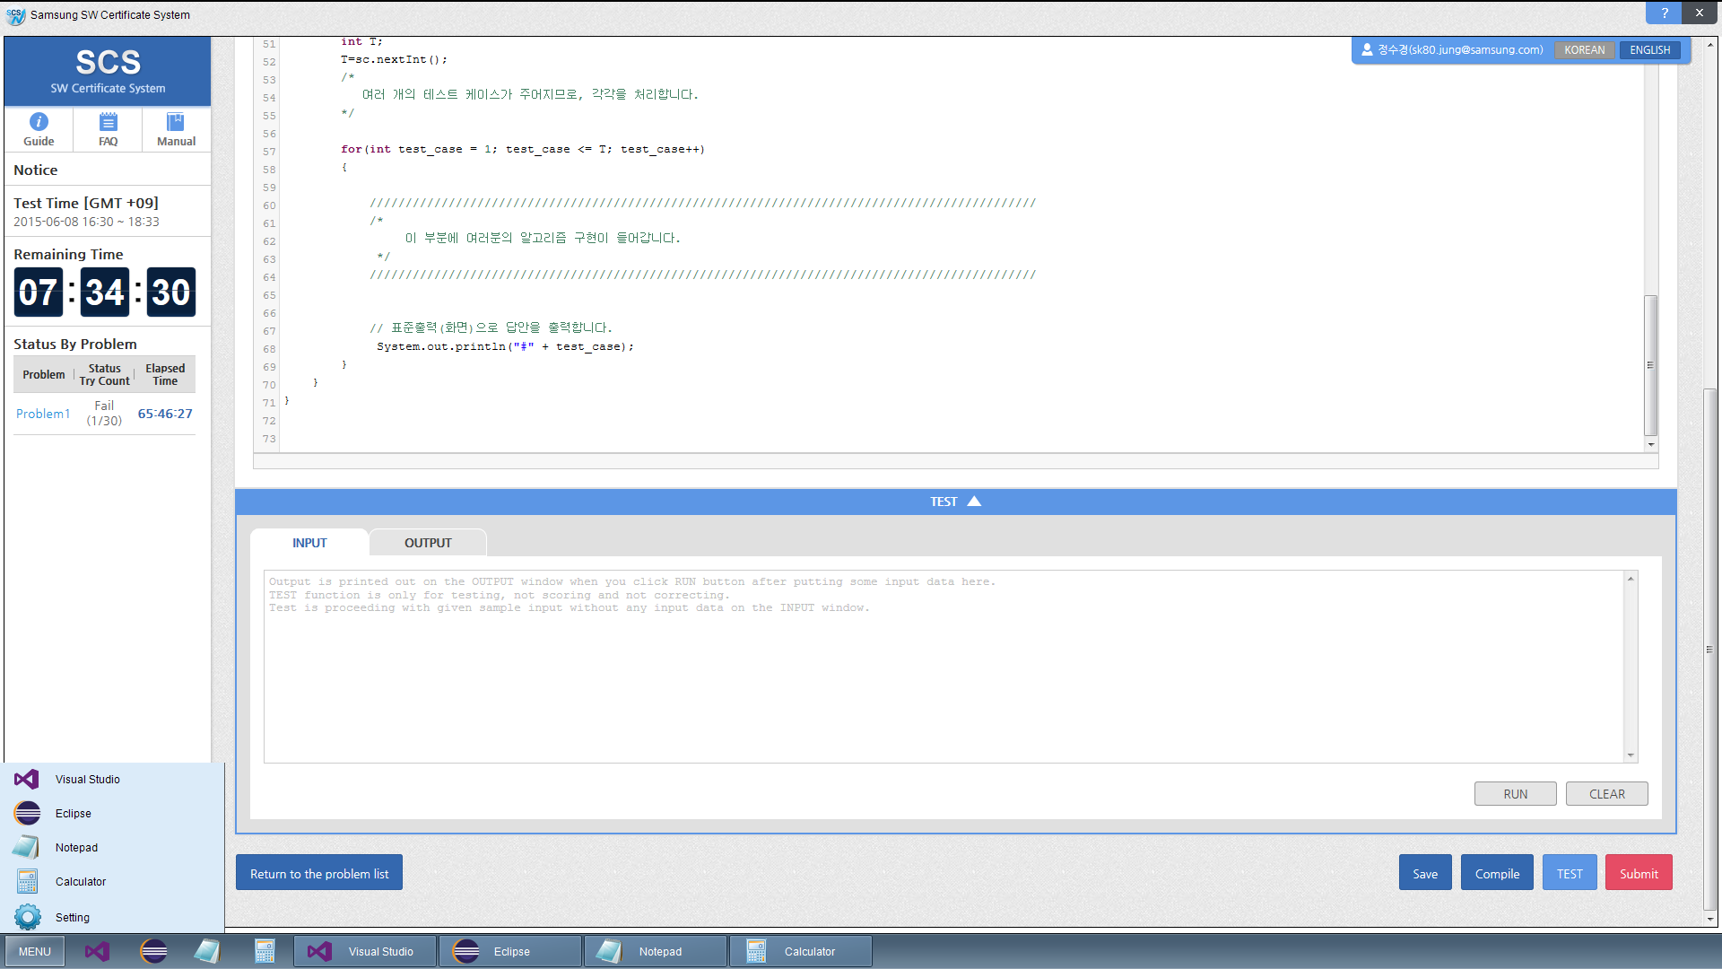
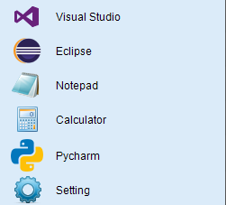
7. Solve Problem (5/6)
IDE Tool Usage
Summary :
Run IDE Tool during test
(Visual Studio, Eclipse, PyCharm, Notepad, Calculator)
Contents :
① Available program list displayed
by “MENU” button.
- Setting :
Route determination of VS, Eclipse, PyCharm
② shortcut icon of available
programs.
③ Currently running programs
displayed
※ Please refer the detail usage of tool
to next page.
1
2
3

Slide 15
7. Solve Problem (6/6)
IDE Tool Usage
Program | Automatically generate items | Project name, File name (# means a number)
Visual Studio | Project cpp file (empty) c file (empty) sample_input.txt (empty) | “Project#” “Project.c” “Project.cpp” “sample_input.txt”
Eclipse | workspace Java Project (empty) sample_input.txt (empty) | “workspace#” “Project” “sample_input.txt”
PyCharm | Project_py.py | Project_py.py
Note Pad | Text file (empty) | “Text#.txt”
① Empty project will be created after running Visual Studio, and empty file will be also created under source folder automatically. (.cpp / .c file) A user may use one of them.
Default workspace will be created after running Eclipse, and a Java project will be also created.
Project_py.py will be created in a project after running PyCharm. User can add solution.py.
(File > New... > Python File (Select),
type “solution”)
Copy a sample_input from the “sample_input pop-up” screen to the sample_input.txt under the each project.
② “Open” or “Save as” functionalities would be restricted in the running programs of the SCS App. If a user save or load a file or project from other folders, it would be considered as cheating.

Slide 16
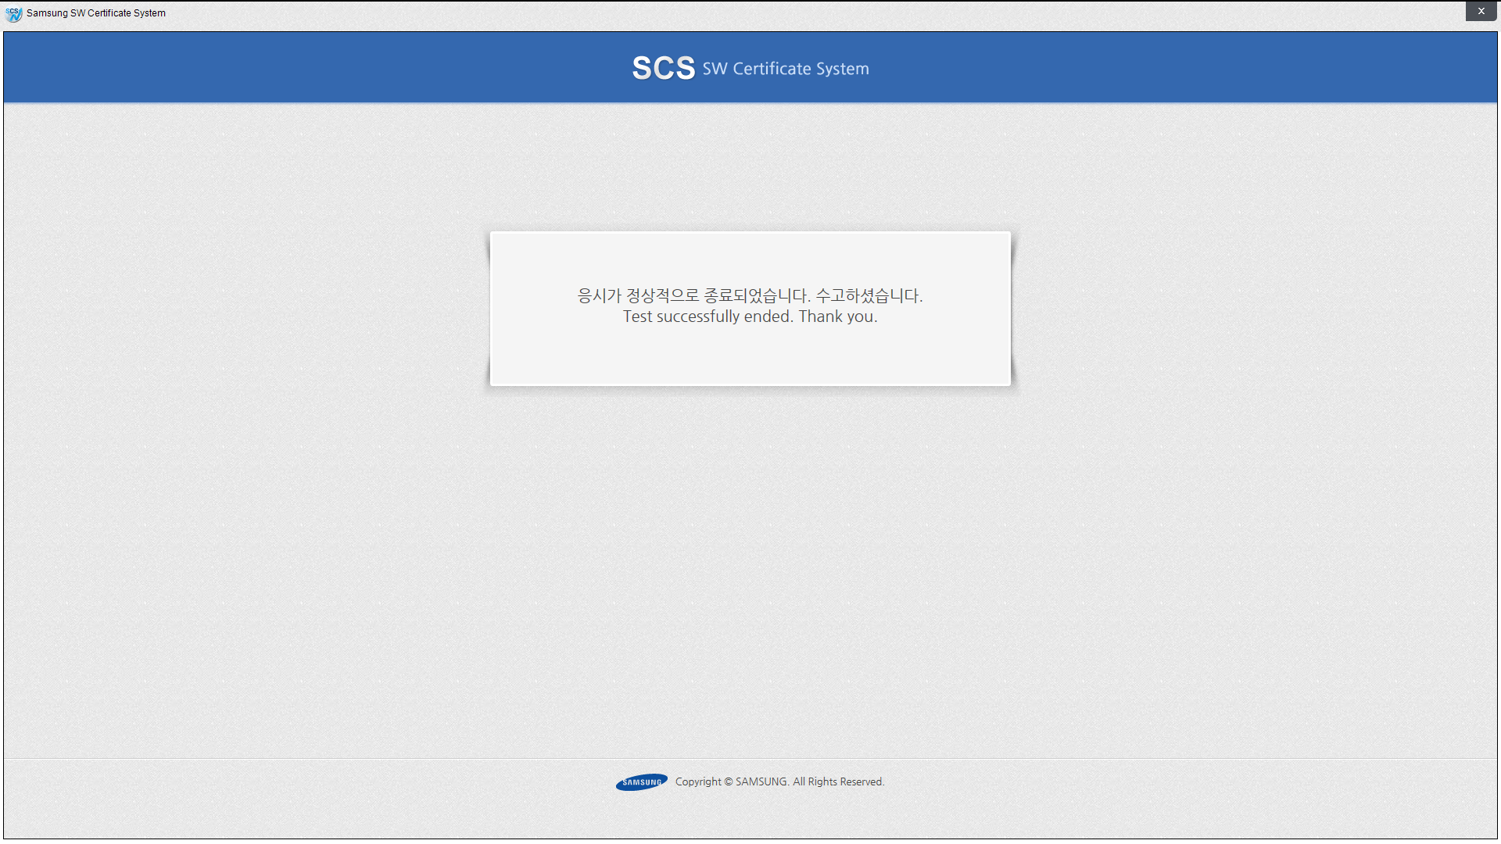
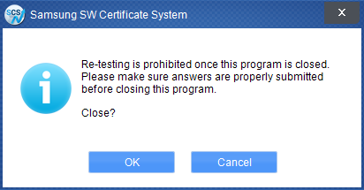
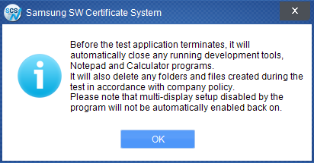
8. End Test & Close SCS App
1
Summary :
Close SCS
Contents :
① Close App
② Close Information 1
- Impossible to start it again after
closing.
- Confirm reporting answers
- Yes click → close
No click → App remained
③ Close Information 2
- Newly installed programs and
saved data will be deleted
automatically during test
(Multi-display setup disabled by
the program will not be
automatically enabled back on)
2
3

Slide 17
9. Detail feature – restricted MS windows configuration
Category |  | Note
Restricted MS windows configuration | Unpermitted Programs restricted | Running unpermitted programs are not allowed. (Allowed programs : Visual Studio, Eclipse, PyCharm, Notepad, Calculator)
 | Network restricted | Access other networks are not allowed except SCS network. (Restricted : FTP, FTP/Telnet, http, network drive)
 | Screen capture restricted | Window Print Screen key, Screen capture programs are not allowed.
 | Access windows folder restricted | Access local folder in the PC is not allowed. (A user can save and run source code or files for test as C:\SCS\)
 | Multi monitor restricted | Multi monitor is not allowed during the test by Samsung policy. (A sub monitor will be removed automatically)
 | Alt + Tap restricted | Assess windows resources by Alt + tap is not allowed.
 | Programs and Data for test deleted | Programs and data for test will be deleted after closing SCS App. (C:\SCS folder deleted automatically)
Allowed programs | Visual Studio, Eclipse, PyCharm, Notepad, and Calculator allowed | A user can use allowed programs and multi instance functionality. (Running short cut provided) File open & Save As function in programs are not allowed.
본 장표는 추가된 장표로
주요 기능을 설명해줄것
제어되는 기능
IDE는 사용될수 있다.
시험중 생성되는 파일은 C:\SCS에 저장되며,
시험종료후 삭제된다 등등.

